Slide 1
Reading data from flat files using Apache Spark

Slide 2

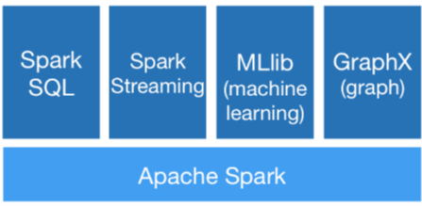
What’s Apache Spark
Lightning-fast unified analytics engine
Notes:
https://spark.apache.org/

Slide 3
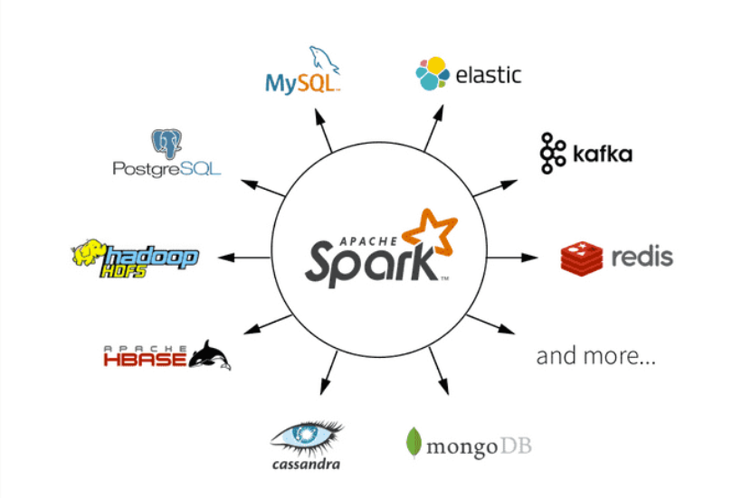
What Apache Spark can do

Slide 4
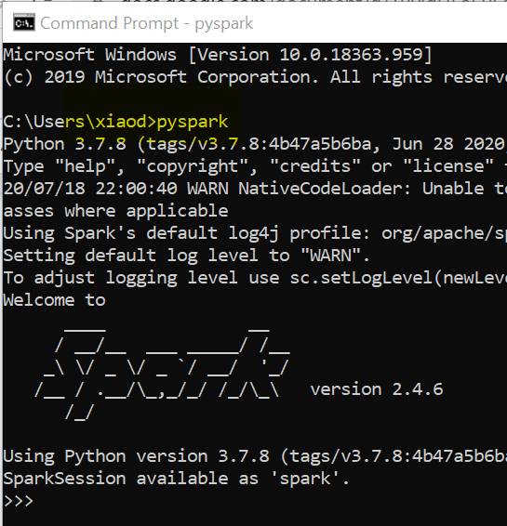
Setup Local Windows Apache Spark env
Java 8 JDK - https://www.oracle.com/java/technologies/javase/javase-jdk8-downloads.html
Python 3.7 - https://www.python.org/downloads/release/python-377
7zip - https://www.7-zip.org/download.html
Apache Spark 2.0 - https://spark.apache.org/downloads.html
Winutils - https://github.com/cdarlint/winutils/tree/master/hadoop-2.7.7/bin
Add Windows User Variable - HADOOP_HOME, SPARK_HOME and PATH

Slide 5
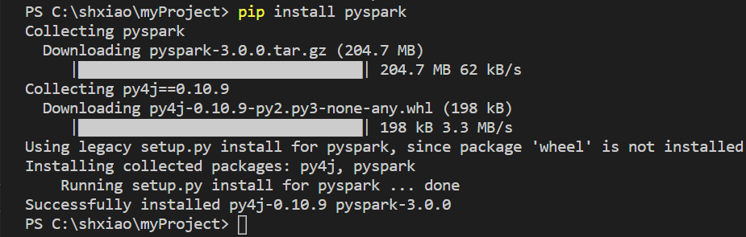
Setup VS Code Apache Spark env
Visual Studio Code - https://code.visualstudio.com
Install Python Extension
Install Pyspark - pip install pyspark==2.4.6

Slide 6
Thanks for watching!
Please leave a comment if you have any questions!
If you like this video, please hit the below LIKE button and Subscribe it..

